Slide 1
Unit 3

Slide 2
What we are going to cover
Understand the difference between virtualization & CC (Cloud Computing)
Get a detail knowledge about CC
Anatomy of CC
Benefits of CC
Steppingstones for the development of CC/History & Evolution of CC
Relationship & Difference between GC (Grid Computing) & CC

Slide 3
Cloud vs Virtualization
Virtualization and Cloud are two different technologies but are related to each other.
It is one of the major building blocks of Cloud.
It is an enabler for Cloud as it provides the flexibility at the hardware level by virtualizing the resources.
This makes it easy to provide and manage the resources.

Slide 4
Cloud vs Virtualization
The real difference between the cloud and virtualization comes from
Business aspect of cloud
Service management framework built into the cloud.
Virtualization is a technology without no direct business benefit other than saving hardware cost to the business while cloud connects the business requirement of end user to technology and can be used to map and fulfil a business requirement.
A virtualized infrastructure has limited built in automation whereas cloud-based infrastructure has complete automation.

Slide 5
Cloud Vs Virtualization
It is recommended to first consolidate physical infrastructure using virtualization and then shift to cloud.
Virtualization and Cloud both bring saving to the business due to consolidation, flexibility and increased manageability.

Slide 6
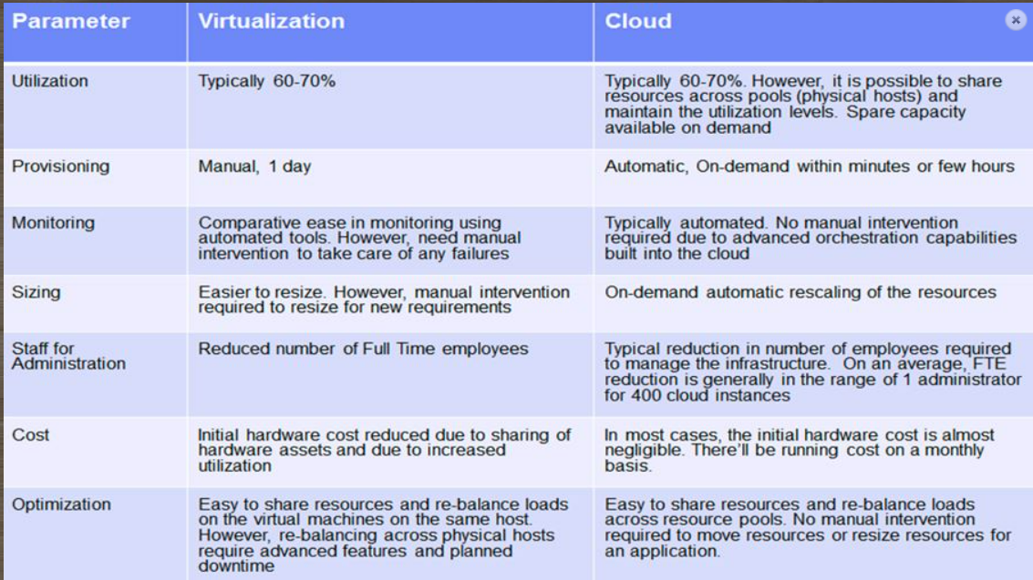

Slide 7
What is Cloud Computing
CC framework attempt to deliver IT services to customer with the following characteristics:
You don’t need to own a cloud computing framework to use IT services.
You have option to subscribe or unsubscribe the services delivered by cloud.
Services are available on demand.
It can scale up and down based upon your usage.
Subscriber gets charged for the services subscribed.
Cloud service delivery model is automated. This is called orchestration.
CSP (Cloud Service Provider) will provide an SLA (Service Level Agreement) for the services defined in the service catalog.
https://www.youtube.com/watch?v=TDqF11rRobg)

Slide 8
Anatomy of Cloud Computing
Cloud computing is composed of 7 major components.
Each component serves a specific function in Cloud.
Not all components are present in every Cloud solution available in the market.
Cloud vendors may choose to implement a subset of features to suit their end-user requirements.
The choice of components may also depend on the Delivery model.
Some of these components may also be partially implemented depending on the deployment model used for Cloud.

Slide 9
Anatomy of Cloud Computing
Provisioning and Configuration Module
Monitoring and Optimization
Metering and Chargeback
Orchestration
CMDB (Configuration Management Database)
Cloud Lifecycle Management Layer
Service Catalog

Slide 10
Anatomy of Cloud Computing
Provisioning and Configuration Module
Provisioning and Configuration layer forms the lowest layer of cloud and typically reside on hardware or on the top of the hypervisor layer.
The function of this layer is to abstract the underlying hardware and provide a standard mechanism to generate instance of virtual machines on demand.
The layer also handles the post-configuration of the operating systems and applications residing on the VM.

Slide 11
Anatomy of Cloud Computing
Monitoring and Optimization Module
This layer handles all the monitoring of all server, storage, networking and application components in Cloud.
Based on this statistics, it could perform routine functions that optimize the behavior of the infrastructure components.
and provide relevant data to the cloud administrator to further optimize the configuration for maximum utilization and performance.

Slide 12

Anatomy of Cloud Computing
Metering and Chargeback Module
This layer provides functions to measure the usage of resources in Cloud.
The metering module collects all the utilization data per domain per user. The module gives the Cloud administrator enough data to measure ongoing utilization of resources and to create invoices based on the usage on a periodic basis.

Slide 13
Anatomy of Cloud Computing
Orchestration Module
Orchestration is central to Cloud operations.
Orchestration converts requests from the Service management layer and the monitoring, chargeback modules to appropriate action items which are then submitted to provisioning and configuration module for final closure.
Orchestration updates the CMDB (Configuration Management Database) in the process.

Slide 14
Anatomy of Cloud Computing
Configuration Management Database (CMDB) Module
CMDB is a central configuration repository wherein all the meta-data and configuration of different modules, resources is kept and updated on a real-time basis.
The repository can then be accessed using standard protocols like SOAP (Simple Object Access Protocol) by third party software and integration components.
All updates to CMDB happen in real-time as requests get processed in Cloud.

Slide 15
Anatomy of Cloud Computing
Cloud Lifecycle Management Layer (CLM) Module
The Layer handles the coordination of all other layers in Cloud.
All requests internal and external are addressed to the CLM layer first.
CLM may internally route requests and actions to other layers for further processing.

Slide 16
Anatomy of Cloud Computing
Service Catalog (SC) Module
Service Catalog is central to the definition of Cloud.
SC defines what kind of services the cloud can provide and at what cost to the end-user.
SC is the first thing that is drafted before a Cloud is architected.
The Service Management Layer consults SC before it processes any request for a new resource.

Slide 17

Benefits of Cloud Computing
Cloud provides tangible business benefits to business.
It saves cost to the business thus improving the bottom line.
It also adds value to the existing business processes by incorporating new functions for increasing efficiency, flexibility, manageability and improved transparency.

Slide 18

Benefits of Cloud Computing
Provisioning is automated and on-demand and can be done on a self-service basis.
The provisioning typically takes from few seconds to few hours.
Also, To prepare for hardware purchase, the need for resources may be calculated well in advance.

Slide 19

Benefits of Cloud Computing
Utilization is typically is around 60-70%.
The freed-up resources goes into a pool which can be assigned transparently to other users.

Slide 20

Benefits of Cloud Computing
Elasticity allows scaling up and down on-demand.
Scalability is on-demand. i.e, add more computing resources on demand.
Capacity can be planned, and operational expenses can be fine-tuned to meet the current demand.

Slide 21

Benefits of Cloud Computing
Availability: since, VM instances are not tied to any specific hardware. they are designed to run over a range of hardware.
Hence, it is possible to restart the instance on secondary hardware if the primary hardware fails.
This happens automatically and transparently.

Slide 22

Benefits of Cloud Computing
Capital Expenditure: Depending on the cloud deployment, a customer saves about 40% in upfront capital expenditure required to procure hardware.
Only customer want to pay fine cost/ running cost on the monthly basis depending upon the usage.
The operational expense can be further fine-tuned based on demand, thus resulting in much higher savings.

Slide 23


Benefits of Cloud Computing
Monitoring in cloud allows for further optimization of resources for maximum utilization and reduced wastage. This can save higher cost over long run.
Based on the cloud implementation, the savings in Cloud may vary.
There are multiple factors that may impact the features of Cloud and the savings and benefits inherent in Cloud.

Slide 24

Cloud Transformation Roadmap
An organization planning to transfer their infrastructure to cloud move through the three major stages of evolution:
Consolidation & Virtualization
Automation & Optimization
Integration of service management

Slide 25
Cloud Transformation Roadmap
Consolidation & Virtualization:
This stage involves moving from a purely physical infrastructure to virtual infrastructure. It is achieved through virtualization and consolidation of all physical assets.
This stage further involves the building of tools for asset management, monitoring, and optimization.

Slide 26
Cloud Transformation Roadmap
Automation & Optimization:
To reduce provisioning and turnaround time, automation and optimization of all services are implemented. This helps in resource migration and load balancing.
Centralized database called Configuration management database (CMDB) to record the configuration of all components is set up.
There will the formation of standard template from all services.
User will use these template to use any services.
These templates will help in the formation of service catalog.

Slide 27




Cloud Transformation Roadmap
Integration of service management:
This stage involve the following activities:
Setting of service catalog for the services available in the cloud.
Integration and working of all eight layers of cloud architecture.

Slide 28
Grid Computing
Grid computing is a type of parallel and distributed system that enables sharing, selection, and aggregation of geographically distributed autonomous resources dynamically at run time depending on their availability, capability, performance, cost and user’s quality of service requirements for solving large scale compute and data intensive applications.
So, in grid computing, we divide a single and large task among many loosely coupled computers to find the solution of the task.

Slide 29
Cloud vs Grid
Grid computing is comprised of many computers working together to achieve one goal while CC is aimed at proving computing resources for independent tasks.
CC resources can be arranged and organized to behave as a computing grid while computing grid can’t behave like cloud.

